Slide 1
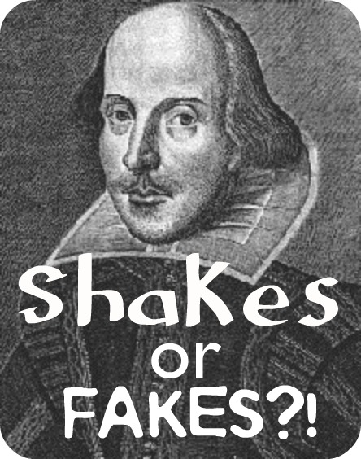

Slide 2
Use the Activ Expression devices to show whether you think the following words and phrases were written by Shakespeare or not!
Press Yes or No to indicate whether you think these phrases were written by Shakespeare or not.

Slide 3
SHAKESPEARE!
‘Better a witty fool than a foolish wit’

Slide 4
SHAKESPEARE!
‘Better three hours too soon than a minute too late’

Slide 5
FAKE! Eminem lyrics
‘To know I hold the weight of boulders on my shoulder blades’

Slide 6
SHAKESPEARE!
‘Neither a borrower nor a lender be’

Slide 7
‘All the world's a stage, and all the men and women merely players’
SHAKESPEARE!

Slide 8
SHAKESPEARE!
‘Give every man thy ear, but few
thy voice’

Slide 9
FAKE! Eminem lyrics
‘I grapple an axe for them baffling acts, The mysterious stab in the backs who dabble in wax’

Slide 10
SHAKESPEARE!
‘what’s here? The portrait of a blinking idiot’

Slide 11
FAKE! Eminem lyrics
‘It’s hatred I spew’

Slide 12
FAKE! Justin Bieber
‘I’m strong enough to climb the highest tower,
And I’m fast enough to run across the sea’

Slide 13
SHAKESPEARE!
‘Can one desire too much of a good thing?’

Slide 14
FAKE! Coldplay lyrics
‘Revolutionaries wait for my head on a silver plate’

Slide 15
FAKE! Cliff Richard lyrics
‘A time for hating and fighting to cease’

Slide 16
SHAKESPEARE!
‘I will speak daggers to her, but use none’

Slide 17
FAKE! Taylor Swift lyrics
‘you were Romeo, you were throwing pebbles
And my Daddy said stay away from Juliet’

