Slide 1
WELCOME TO SHAKESPEARE
English 9

Slide 2
Which of these movies is not based off of a Shakespearean play?
The Lion King
10 Things I hate about you
She’s the Man
Pocahontas
Frozen
Hamlet
The Taming of the Shrew
Twelfth Night
The Tempest
NOT Shakespearean

Slide 3
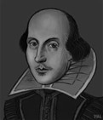
Shakespeare Background
Born during the Black Plague
(1564-1616)
Married early, but left family to become a playwright in London
Became wealthy and retired back to Stratford

Slide 4
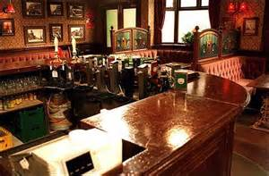
Shakespeare Background
Wrote in bars and pubs because:
Free light from candles
Cheap food
Inspiration

Slide 5
Levels of Shakespearean Writing
Sex/love/magic
Lowest or basic level. For the uneducated
Plot
For the middle class & those that want to know first and foremost what happens.
Poetic Language
Reserved for the educated, usually the clergy or royalty
Universal Truths
Reserved for those that think and are educated (critics, clergy, and/or royalty)

Slide 6
Three Types of Plays
Histories
Tell the history of the Kings of England
Boring for Canadian students
Tragedies
Very important people (kings, princes…)
Very important things (wars, marriages, battles…)
Tragic hero with a tragic flaw
Magic or fantasy
Hero often dies
Comedies
End well and not necessarily funny
Usually end in at least one marriage
Confused gender/identity
Magic or fairy involvement

Slide 7
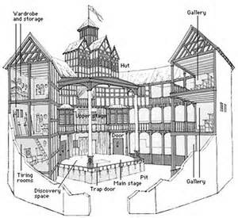
Globe Theatre
Pennystinkers/ Lower Class
First level
Closest to the stage
Middle Class
At the bottom, on the benches behind the Pennystinkers
Royalty/ Clergy
Upper levels, away from Pennystinkers

Slide 8
T-Chart
Bandit
Employer
Schoolboy
Bump
Glow
Alligator
Eyeball
Puppy-dog
Fairy land
Blushing
Excitement
Luggage
Hot-blooded
Successful
Upstairs/downstairs
Wild-goose chase
For goodness’ sake
A sorry sight
Eaten me out of house and home
Good riddance
What the dickens!
Puke!

